Slide 1
Introduction to Rails
Chris Cumming

Slide 2


Who am I? (i.e. Shameless Self Promotion)
Software Consultant http://nftb.saturdaymp.com @saturdaymp chris.cumming@satudaymp.com Chris C on Dev Edmonton Slack

Slide 3
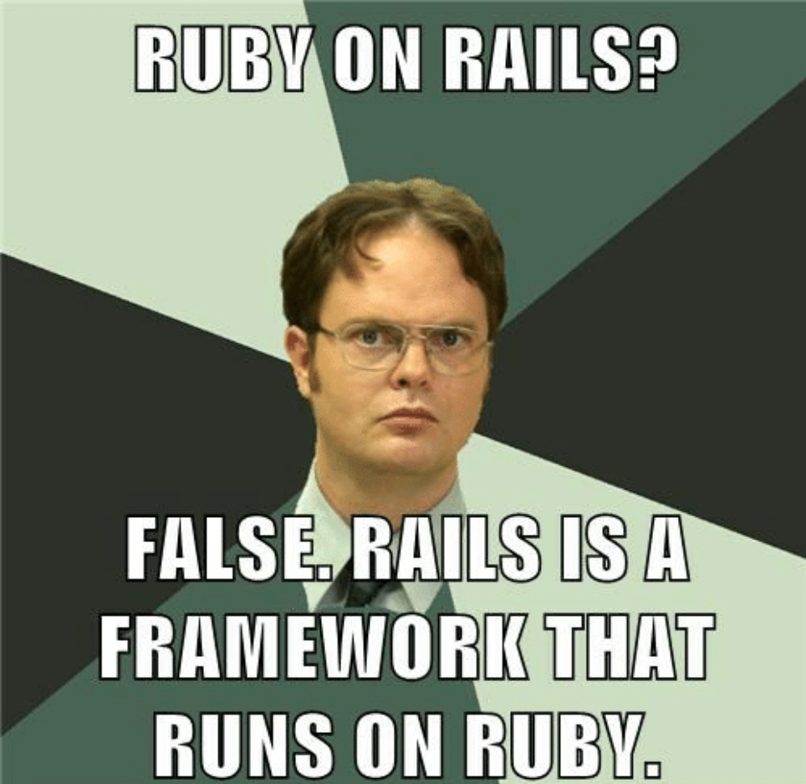
What is Ruby on Rails?
A web framework built on top of Ruby.
“Ruby on Rails is not a minimalist framework, it's a metropolis. One filled with all the major institutions needed to run a large, sprawling application like Basecamp or GitHub or Shopify.”
https://rubyonrails.org/everything-you-need/
Notes:
Take poll of who is familiar with Ruby and Rails.
Ruby on Rails, or Rails, is a server-side web application framework written in Ruby under the MIT License. Rails is a model–view–controller (MVC) framework, providing default structures for a database, a web service, and web pages. It encourages and facilitates the use of web standards such as JSON or XML for data transfer and HTML, CSS and JavaScript for user interfacing. In addition to MVC, Rails emphasizes the use of other well-known software engineering patterns and paradigms, including convention over configuration (CoC), don't repeat yourself (DRY), and the active record pattern.
Wikipedia

Slide 4
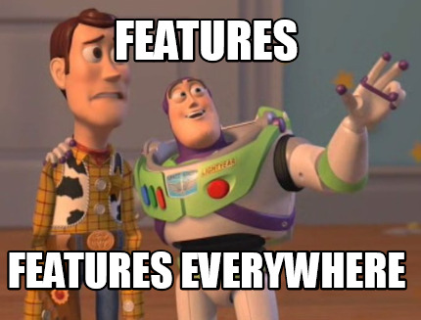
Rails Features
Convention over Configuration (i.e. Magic)
Model, View, Controller (MVC)
Active Record, View, Controller
Database Setup/Migrations
RESTful
Package management (Gemfile)
Generators
Webpacker
Testing frameworks
Notes:
Ask for any other features.
Explain MVC if people don’t know what it is.
Rails popularized database migrations.
Testing frameworks: mini-test, rspec, cucumber, capybara, etc.

Slide 5

Pros and Cons of Rails
Pros:
Active community and 3rd party libraries
Most of the tools you need to build a website included
Well defined project structure
Cons
Magic
Hard to maintain
Ruby not type safe (getting their with Ruby 3 and/or Sorbet)
Notes:
Rails is well supported and has an active community. Lots of websites are powered by Rails.
The project structure used for Rails was copied by other projects such as ASP.NET MVC.
The magic is a pro but for new users it’s a big con. How did this happen? Forget to pluralize or singuralize a file name then you are in trouble.
Hard to tell pieces are used.
If you delete a route did you remember to delete the controller, views, etc. Working on legacy apps often find dead code but it’s hard to tell if it’s really dead.
Ask for other pros and cons.

Slide 6
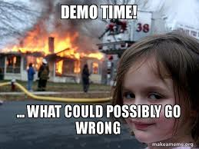
Demo Time
Getting Started with Rails https://guides.rubyonrails.org/getting_started.html
Notes:
Run through the getting started guide to create a blog.
Use the Docker image.
Run it to show it working.
Change homepage.
Generate model for article and migration.
Show in DB.
Show list of articles.
CRUD for articles.
Create comment article using generator.
Associate it with article.

Slide 7
Learn More
Rails Getting Started https://guides.rubyonrails.org/getting_started.html
Rails Template https://github.com/saturdaymp-examples/rails-template
Presentation https://github.com/saturdaymp-examples/introduction-to-rails
Contact chris.cumming@satudaymp.com @saturdaymp Chris C on Dev Edmonton Slack

